Slide 1
SIMULATION AND MODELING
ENCT353
Er. Ranjila Shrestha

Slide 2
Course Objectives:
The objective of this course is to develop knowledge of modeling and simulation techniques for discrete and continuous systems. It emphasizes the development and analysis of simulation models, generation and testing of random numbers and variables, and application of simulation methods to evaluate the performance of stochastic systems

Slide 3
Chapter-1
Introduction to Simulation

Slide 4
Overview
1.1 System and system environment concepts
1.2 Continuous and discrete systems
1.3 Types of models
1.4 Model development life cycle
1.5 Simulation and steps in simulation study
1.6 Advantages and disadvantages of simulation
1.7 Monte-Carlo simulation
1.8 Discrete-event system simulation

Slide 5
1.1 System and system environment concepts
System
The term system is derived from the Greek word systema, which means an organized relationship among functioning units or components.
System exists because it is designed to achieve one or more objectives.
We come into daily contact with the transportation system, the telephone system, the accounting system, the production system, and for two decades the computer system.
There are more than a hundred definitions of the word system, but most seem to have a common thread that suggests that a system is an orderly grouping of interdependent components linked together according to a plan to achieve a specific objective.

Slide 6
1.1 System and system environment concepts
System
In a simple term “A system is a collection of components or entities that interact together to achieve a specific goal.”
The study of the systems concepts, then, has three basic implications:
A system must be designed to achieve a predetermined objective.
Interrelationships and interdependence must exist among the components.
The objectives of the organization as a whole have a higher priority than the objectives of its subsystems.

Slide 7
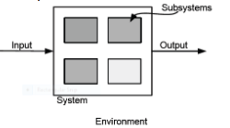
1.1 System and system environment concepts
System
Assembly of objects joined in some regular interaction or interdependence.
A system exists and operates in time and space bounded inside system boundary

Slide 8
1.1 System and system environment concepts
System Components/ System Concepts – terms
Entity = The object of interest of a system. An object that passes through the system. e.g. cars, buses in a traffic system
Attributes = property/characteristics of an entity
Activity = the process that causes change in the system
Event = An instantaneous occurrence that may change the state of the system.
State = collection of variables necessary to describe the system at any time.

Slide 9
Examples
System | Entities | Attributes | Activities | Event
Traffic | Cars, Buses | Speed, Distance | Driving, Stopping | Arrival, Departure
Bank | Customers | Balance, Credit Status | Depositing Cash, Cash Withdrawal | Arrival, Departure
Communication | Message | Length, Priority | Transmitting Message | Message Breakdown
Supermarket | Customers | Shopping List | Clearance | Arrival, Departure

Slide 10
1.1 System and system environment concepts
System
Klir* gives a collection of 24 definitions one such definition is “ A system is a collection of components wherein individual components are constrained by connecting interrelationships such that the system as a whole fulfills some specific functions in response to varying demands”.
Hence, system is a collection of entities that act and interact together toward the accomplishment of some logical end (computer, network, communication systems, queuing systems etc.)
*Klir, George J. , an approach to general systems theory, New York: Van Nostrand Reinhold Co,1969

Slide 11
1.1 System and system environment concepts
System Environment
The system environment consists of external factors that influence the system but are not part of it.
The changes occurring outside the system that affect the system is system environment.
System may produce changes that do not react on the system but on the environment.
A system is affected by the change in the environment.
Example in a supermarket the factors controlling the arrival of the customers in the supermarket are outside the influence of supermarket and hence they are the part of environment.

Slide 12
Types of Activities
On the basis of place of Occurrence:
Endogenous Activities – activities occurring within the system. Example: packaging, cheque clearing, etc.
Exogenous Activities – activities occurring between the system and the environment. Example: Arriving customers
On the basis of its effect:
Deterministic Activities – the outcome of the activity can be described completely in terms of its input. Example: switch off = no lights
Non- Deterministic (Astochastic) Activities – the effect of the activity vary randomly over various possible outcomes. The random outcome can be measured and described in the form of probability distribution. Example: power failure

Slide 13
1.2 Continuous and discrete systems
System is broadly categories into two types:
1. Continuous System
System for which the state variables change continuously with respect to time.
Continuous simulation is appropriate for systems with a continuous state that changes continuously over time.
Examples:
  Temperature in a room: Changes gradually based on heating/cooling
  Aircraft flight: Altitude, speed, position change continuously
  Chemical reactions: Concentration levels change smoothly
  Water tank drainage: Water level decreases continuously
  Vehicle motion: Speed and position change continuously

Slide 14
1.2 Continuous and discrete systems
2. Discrete System
system for which the state variables change instantaneously at separated points in time
Discrete simulation is appropriate for systems whose state is discrete and changes at particular time point and then remains in that state for some time.
Examples
Bank queue: Customers arrive/depart at specific times; queue length jumps from 5 to 6
Traffic light: Changes from red → green → yellow at discrete moments
Manufacturing: Parts are completed at specific times; inventory counts change suddenly
Computer network: Packets arrive/depart at specific intervals

Slide 15
1.3 Types of models
Model
It is a simplification of the reality.
A (usually miniature) representation of something; an example for imitation or emulation.
A model is a representation of the construction and working of some system of interest.
A model is similar to but simpler than the system it represents.
One purpose of a model is to enable the analyst to predict the effect of changes to the system.
A model is a simplified representation of a system at some particular point in time or space intended to promote understanding of the real system.

Slide 16
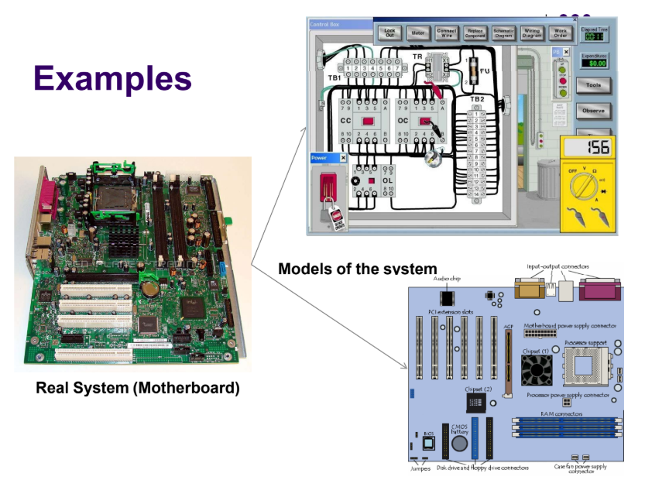

Slide 17
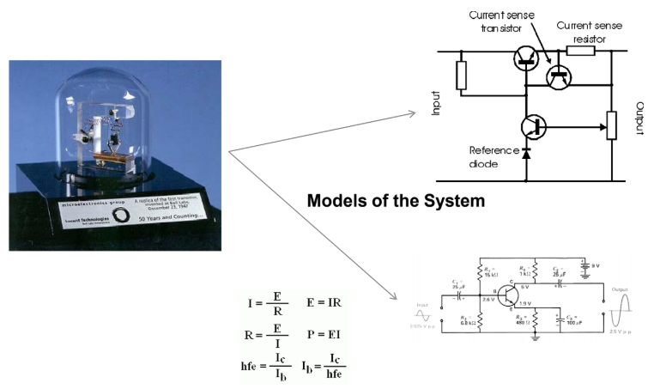

Slide 18
1.3 Types of models
System Modeling
The model should be sufficiently detailed to permit valid conclusions to be drawn about the real system
Modeling is the process of producing a model; On the one hand, a model should be a close approximation to the real system and incorporate most of its salient/relevant features.
On the other hand, it should not be so complex that it is impossible to understand and experiment with it.
A good model is a judicious tradeoff between realism and simplicity.

Slide 19
1.3 Types of models
System Modeling
“Modeling is the use of mathematical techniques, specialized hardware and engineering judgment to create a representative stand for a real world environment, device, system or behavior.”
Modeling of system could be categorized into 2 main tasks:
Establishing model structure: determines system boundaries, identify attributes, entities and activities of system.
Supplying the data: provide the values for the attributes and define relationship involved in the activities.

Slide 20
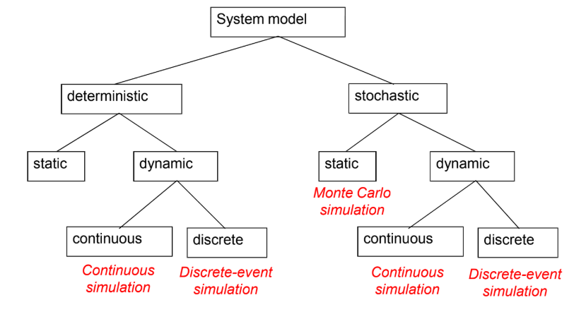
1.3 Types of models
On the basis of the nature of the system, Model of a system can be classified as:

Slide 21
1.3 Types of models
Simulation models can be classified as being static or dynamic, deterministic or stochastic and discrete or continuous.
Deterministic models have a known set of inputs, which result into unique set of outputs.
In stochastic model, there are one or more random input variables, which lead to random outputs.
A static simulation model represents a system, which does not change with time or represents the system at a particular point in time.
Dynamic simulation models represent systems as they change over time.
System in which the state of the system changes continuously with time are called continuous systems while the systems in which the state changes abruptly at discrete points in time called discrete systems.

Slide 22
1.3 Types of models
Stochastic vs. Deterministic
Stochastic simulation
There are one or more random input variables which leads to random outputs.
a simulation that contains random (probabilistic) elements. Examples:- Inter-arrival time or service time of customers at a restaurant or store, Amount of time required to service a customer.
Output is a random quantity (multiple runs required analyze output)
Deterministic simulation
Models have a known set of inputs which result into unique set of outputs.
a simulation containing no random elements. Examples:- Simulation of a digital circuit, Simulation of a chemical reaction based on differential equations
Output is deterministic for a given set of inputs.

Slide 23
1.3 Types of models
Static vs. Dynamic Models
Static models
Model where time is not a significant variable.
This model represents a system, which does not change with time or represents a system at a particular point in time.
Examples:- Determine the probability of a winning solitaire hand
Dynamic models
Represents a system that changes over time.
Model focusing on the evolution of the system under investigation over time
Example: Traffic simulation

Slide 24
1.3 Types of models
Continuous vs. Discrete
Discrete
Model represents the system in which state changes abruptly at discrete points of time.
State of the system is viewed as changing at discrete points in time.
An event is associated with each state transition.
Events contain time stamp.
Continuous
Model represents the system in which state changes continuously with time.
State of the system is viewed as changing continuously across time.
System typically described by a set of differential equations.

Slide 25
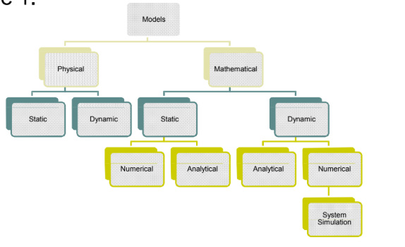
1.3 Types of models
On the basis of the representation, Models used in system can be classified as:

Slide 26
1.3 Types of models
1. Physical Model
Physical models are based on some analogy between such systems as mechanical and electrical or electrical and hydraulic.
In a physical model of a system, the system attributes are represented by such measurements as a voltage or the position of a shaft.
The system activities are reflected in the physical laws that drive the model.
These models are known as iconic models.
Example: Architect Modelling
2. Mathematical Models
Mathematical models use symbolic notation and mathematical equation to represent a system.
The system attributes are represented by variables, and the activities are represented by mathematical functions that interrelate the variables.

Slide 27
1.3 Types of models
3. Static Models
These models can only show the values that system attributes take when the system is in balance i.e. representation of a system at a particular time or that may be used to represent the system in which time simply play no role.
Static modeling includes class diagram and object diagrams and helps in depicting static constituents of the system.
These models are rigid in nature as it is a time-independent view of the system.

Slide 28
1.3 Types of models
4. Dynamic Model
These models represents the system that evolves over time which is resulted from system activity.
It is the runtime model of the system.
These models consists of sequence of operations, state changes, activities, interactions and memory.
Dynamic models are flexible as it can be changed in real time.

Slide 29
1.3 Types of models
5. Numerical Model
The model apply computational procedure to solve equations.
Some analytical solution can become very complex requiring huge computing resources.
In such case, the model must be studied using numerical model.
Any assignment of numerical values that uses mathematical tables involves the numerical methods.
6. Analytical Model
These model used the deductive reasoning of mathematical theory to solve a problem.
Once we build mathematical model, it must then be examined to see how it can be used to answer the question of interest about the system it is supposed to represent.
If a model is simple enough, it may be possible to work with its relationship and quantities to get an exact analytical solutions.
In practice, only a certain form of equation can be solved analytically.
Example: Boolean Equation

Slide 30
Differences between static modeling and dynamic modeling
The most notable difference between static and dynamic models of a system is that while a dynamic model refers to runtime model of the system, static model is the model of the system not during runtime.
Another difference lies in the use of differential equations in dynamic model. Dynamic models keep changing with reference to time whereas static models are at equilibrium of in a steady state.
Static modeling includes class diagram and object diagrams and help in depicting static constituents of the system.
Dynamic modeling on the other hand consists of sequence of operations, state changes, activities, interactions and memory.
Static modeling is more rigid than dynamic modeling as it is a time independent view of a system. It cannot be changed in real time and this is why it is referred to as static modeling.
Dynamic modeling is flexible as it can be changed in real time.

Slide 31
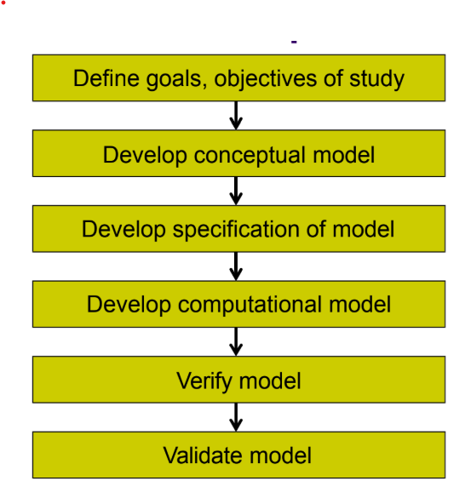
1.4 Model development life cycle
The Model Development Life Cycle is the step-by-step process used to create a simulation model of a real system.
It helps us:
understand the system,
build the model,
and test how the system behaves.
Fundamentally an iterative process

Slide 32
1.4 Model development life cycle
1. Define goals, objectives of Study
Define the objective of simulation of the system of your choice.
2. Develop Conceptual Model
Study the existing real system, its entities and attributes and develop its conceptual model.
3. Develop Specification of Model
A more detailed information of the model including more specific attributes, required data, necessary algorithm, empirical data are collected.
E.g. for traffic system: road geometry, signal timing, expected traffic demand, driver behavior, path planning for vehicles, etc.

Slide 33
1.4 Model development life cycle
4. Develop Computational Model
Executable simulation model follows software approach using either general purpose programming language, special purpose simulation language or simulation package.
While developing computational model, other non-functional requirement like performance, inter-operability with other tools/data are also considered.
5. Verification
Deals with following question: “Did I build the model right?”
Does the computational model match the specification model?
Largely a software engineering activity (debugging)

Slide 34
1.4 Model development life cycle
6. Validation
Did I build the right model?
Does the computational model match the actual (or envisioned) system?
Typically, compare against:
  measurement of actual system
  an analytical (mathematical) model of the system.
By necessity always an incomplete activity.

Slide 35
1.5 Simulation and steps in simulation study
Simulation
A simulation of a system is the operation of a model of the system.
It is an experiment in a computer where the real system is replaced by the execution of the program.
It is a program that mimics (imitate) the behavior of the real system.
Simulation is a tool to evaluate the performance of a system, existing or proposed, under different configurations of interest and over long periods of real time.
A simulation is the manipulation of a model in such a way that it operates on time or space to compress it, thus enabling one to perceive the interactions that would not otherwise be apparent because of their separation in time or space.

Slide 36
1.5 Simulation and steps in simulation study
Simulation
Simulation is used before an existing system is altered or a new system built, to reduce the chances of failure to meet specifications, to eliminate unforeseen bottlenecks, to prevent under or over-utilization of resources, and to optimize system performance
Can be used to study simple models but should not use it if an analytical solution is available. Real power of simulation is in studying complex models.

Slide 37
1.5 Simulation and steps in simulation study
Why Simulate?
It may be too difficult, hazardous, or expensive to observe a real, operational system
Parts of the system may not be observable (e.g., internals of a silicon chip or biological system)
Uses of simulations
Analyze systems before they are built
Reduce number of design mistakes
Optimize design
Analyze operational systems
Create virtual environments for training, entertainment

Slide 38
1.5 Simulation and steps in simulation study
When to use Simulation?
Over the years tremendous developments have taken place in computing capabilities and in special purpose simulation languages, and in simulation methodologies. The use of simulation techniques has also become widespread. Following are some of the purposes for which simulation may be used.
Simulation is very useful for experiments with the internal interactions of a complex system, or of a subsystem within a complex system.
Simulation can be employed to experiment with new designs and policies, before implementing.
Simulation can be used to verify the results obtained by analytical methods and reinforce the analytical techniques.
Simulation is very useful in determining the influence of changes in input variables on the output of the system.
Simulation helps in suggesting modifications in the system under investigation for its optimal performance.
By simulating different capabilities for a machine, requirement can be determined.
By changing simulation inputs and observing the result outputs valuable information can be analyzed.

Slide 39
1.5 Simulation and steps in simulation study
Simulation not as an Appropriate Tool
Simulation should not be used when the problem can be solve by using common sense. Example: Customer care
It should not be used:
If the system problem can be solved analytically.
If it is easier to perform direct experiment.
If the resource or time is not available.
If there is unavailability of verification and validation.
If no data is available.

Slide 40
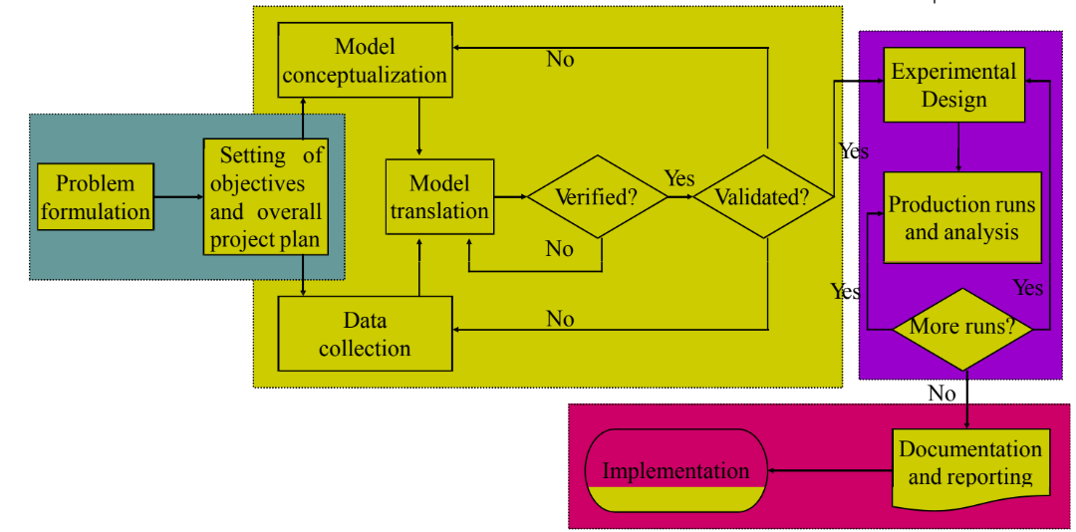
1.5 Simulation and steps in simulation study
Steps in simulation study

Slide 41
1.5 Simulation and steps in simulation study
Simulation is a very general method of studying problems. No formal procedure can be given for showing how a simulation study will proceed. Above figure shows the general steps involved.
Problem Formulation
Initial step is to describe the problem to be solved. It should be a clear statement of what questions are being asked and what measurements need to be taken in order to answer these questions.
Setting of Objectives
The objectives indicate the questions to be answered by simulation. Assuming that the simulation is appropriate, the overall project plan should include a statement of the alternative system to be considered, the cost of study, number of days required, etc.
Model Conceptualization
It is best to start with a simple model and build towards greater complexity. The art of modeling is enhanced by an ability to abstract the essential features of a problem, to select and modify basic assumptions that characterize the system and then to enrich and elaborate the model until an useful approximations results.

Slide 42
1.5 Simulation and steps in simulation study
4. Data Collection
Begins usually together with the early stages of model building. As the complexity of model changes, the required data elements can also change.
5. Model Translation
Most real world system result in models that require a great deal of information storage and computation, so the model must be entered into a computer recognizable format. The modeler must decide whether to program the model in a simulation language or to use special-purpose simulation software.
6. Verified?
Is this computer program performing properly? With complex models, it is difficult to translate a model successfully without a good deal of debugging. If the input parameters and logical structure of the model are correctly represented, verification has been completed.

Slide 43
1.5 Simulation and steps in simulation study
7. Validated?
It is usually achieved through the calibration of the model.
8. Experimental Design
The alternatives that are to be simulated must be determined. The decision concerning which alternatives to simulate will be a function of runs that have been completed and analyzed.
9. Production Runs and Analysis
Production runs and their subsequent analysis are used to estimate measures of performance for the system design that are being simulated.

Slide 44
1.5 Simulation and steps in simulation study
10. More Runs?
Given the analysis of runs that have been completed, the analyst determines whether additional runs are needed and what design these additional experiments should follow.
11. Documentation and Reporting
There are two types of documentation: Program and Progress.
Program documentation is necessary for numerous reasons. It helps to make decisions and helps to modify the program.
Progress report provides important written history of a simulation project.
The final report should include: a model specification, prototype demonstrations, animations, program documentation, progress report and presentations.

Slide 45
1.6 Advantages and disadvantages of simulation
Advantages of Simulation
Simulation helps to learn about real system, without having the system at all. For example the wind tunnel testing of the model of an aeroplane does not require a full sized plane.
In many situations experimenting with actual system may not be possible at all. For example, it is not possible to conduct experiment, to study the behavior of a man on the surface of moon. In some other situations, even if experimentation is possible, it may be too costly and risky,
In the real system, the changes we want to study may take place too slowly or too fast to be observed conveniently. Computer simulation can compress the performance of a system over years into a few minutes of computer running time.

Slide 46
1.6 Advantages and disadvantages of simulation
Advantages of Simulation
Conversely, in systems like nuclear reactors where millions of events take place per second, simulation can expand the time to required level.
Through simulation, management can foresee the difficulties and bottlenecks, which may come up due to the introduction of new machines, equipment and processes. It thus eliminates the need of costly trial and error method of trying out the new concepts.
Simulation Models are comparatively flexible and can be modified to accommodate the changing environment to the real situation.

Slide 47
1.6 Advantages and disadvantages of simulation
Advantages of Simulation
Extensive computer software packages are available, making it very convenient to use fairly sophisticated simulation models.
Simulation is a very good tool of training and has advantageously been used for training the operating and managerial staff in the operation of complex system. Space engineers simulate space flights in laboratories to train the future astronauts for working in weightless environment.
Airline pilots are given extensive training on flight simulators, before they are allowed to handle real planes.

Slide 48
1.6 Advantages and disadvantages of simulation
Disadvantages of Simulation
Model building requires special training. It is an art that is learned over time and through experience. Furthermore, if two models are constructed by two competent individuals, they may have similarities, but it is highly unlike that they will be the same.
Simulation results may be difficult to interpret. Since most simulation outputs are essentially random variables, it may be hard to determine whether an observation is a result of system interrelations or randomness.
Simulation is used in some cases when an analytical solution is possible, or even preferable.
Simulation modeling and analysis can be time consuming and expensive.

Slide 49
Limitations of Simulation
Simulation generates a way of evaluating solutions but does not generate solution themselves.
Simulation is not precise. It does not yield an answer but merely provides a set of the system’s responses to different operating conditions. In many cases, this lack of precision is difficult to measure.
It is a trial and error method that may produce different solutions in repeated runs.
A good simulation model may be very expensive. Simulation often requires a significant amount of computer time and is therefore expensive.

Slide 50
Areas of Application
Manufacturing: Design analysis and optimization of production system, materials management, capacity planning, layout planning, and performance evaluation, evaluation of process quality.
Business: Market analysis, prediction of consumer behavior, and optimization of marketing strategy and logistics, comparative evaluation of marketing campaigns.
Military: Testing of alternative combat strategies, air operations, sea operations, simulated war exercises, practicing ordinance effectiveness, inventory management.
Healthcare applications: such as planning of health services, expected patient density, facilities requirement, hospital staffing , estimating the effectiveness of a health care program.

Slide 51
Areas of Application
Communication Applications: Such as network design, and optimization, evaluating network reliability, manpower planning, sizing of message buffers.
Computer Applications: Such as designing hardware configurations and operating system protocols, sharing networking. Client/Server system architecture
Economic applications: such as portfolio management, forecasting impact of Govt. Policies and international market fluctuations on the economy. Budgeting and forecasting market fluctuations.
Transportation applications: Design and testing of alternative transportation policies, transportation networks-roads, railways, airways etc. Evaluation of timetables, traffic planning.

Slide 52
Areas of Application
Environment application: Solid waste management, performance evaluation of environmental programs, valuation of pollution control systems.
Biological applications: Such as population genetics and spread of epidemics.
Business process Re-engineering: Integrating business process re-engineering with image –based work flow, using process modeling and analysis tool.

Slide 53
1.7 Monte-Carlo simulation
Simulation can also be defined as a technique of performing sampling experiments on the model of the system.
This is called stochastic simulation and is a part of simulation techniques.
Because sampling from a particular probability distribution involves the use of random numbers, stochastic simulation is sometimes called Monte Carlo Simulation
Monte Carlo simulation is a computational technique that uses random sampling to solve problems and estimate numerical results.
It works by running many random simulations to approximate the behavior of a system when analytical solutions are difficult or impossible.

Slide 54
1.7 Monte-Carlo simulation
How Monte Carlo Simulation Works?
1. Define the Problem
  Identify variables with uncertainty
  Determine their probability distributions
2. Generate Random Values
  Create random samples from each variable's distribution
  Use random number generators
3. Run Simulation
  Calculate outcomes using the random values
  Repeat thousands or millions of times
  Each iteration uses a different random sample
4. Analyze Results
  Collect all outcomes
  Calculate statistics (average, standard deviation, percentiles)
  Visualize distribution of results

Slide 55
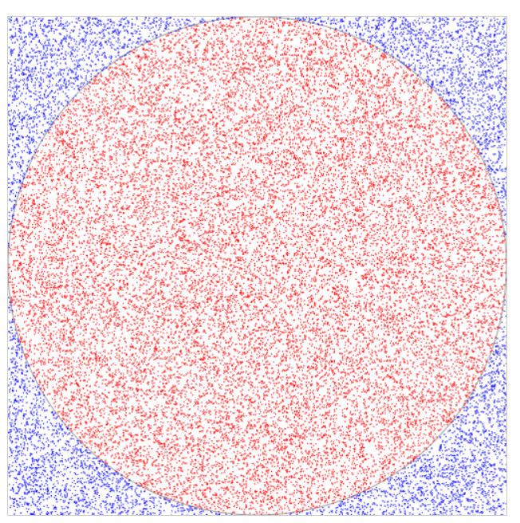
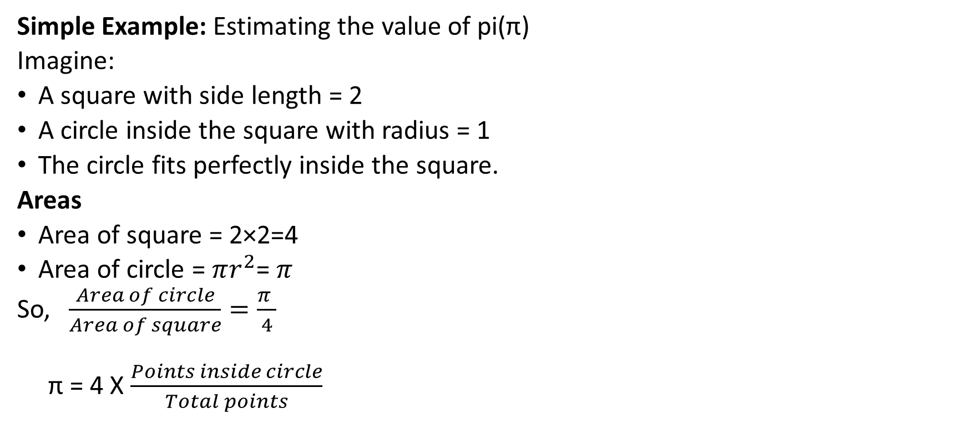
1.7 Monte-Carlo simulation
Simple Example: Estimating the value of pi(π)
Imagine:
A square with side length = 2
A circle inside the square with radius = 1
The circle fits perfectly inside the square.
Areas
Area of square = 2×2=4
Area of circle = $πr^{2}$= $π$
So, $\frac{Area of circle}{Area of square}=\frac{π }{4}$
π = 4 X $\frac{Points inside circle}{Total points}$

Slide 56
1.7 Monte-Carlo simulation
Simple Example: Estimating the value of pi(π)
Algorithm
Generate a random point (x, y) inside a square of side 2 centered at the origin.
Determine whether the point falls inside the unit circle inscribed in the square by checking whether x² + y² <= 1.
Repeat steps 1 and 2 for a large number of points (e.g., 10⁷).
Calculate the ratio of the number of points that fell inside the circle to the total number of points generated.
Multiply the ratio by 4 to estimate the value of pi.

Slide 57
1.7 Monte-Carlo simulation
Simple Example: Estimating the value of pi(π)
Results (Assumptions)
10 points: π ≈ 3.2
100 points: π ≈ 3.16
1,000 points: π ≈ 3.142
10,000 points: π ≈ 3.1416
1,000,000 points: π ≈ 3.141592...

Slide 58
1.7 Monte-Carlo simulation
Assignment
Q. Advantages and Disadvantages of Monte Carlo simulation
Q. Applications of Monte Carlo Simulation

Slide 59
1.7 Monte-Carlo simulation
Q. A bakery keeps records of a popular brand of cake:
Given set of Random Numbers:
48,78,09,51,56,77,15,14,68 and 09
i) Using these sequences, simulate demand for next 10 days.
ii) Also find stock situation if owner made 35 cake/day.
iii) Also find average daily demand on the basis of simulated data.
Daily Demand | 0 | 15 | 25 | 35 | 45 | 50
Probability | 0.01 | 0.15 | 0.20 | 0.50 | 0.12 | 0.02

Slide 60
Steps:
Establish probability distribution
Cumulative Probability Distribution
Setting Random Number Interval
Generating Random Number
Finding the answer of the question

Slide 61
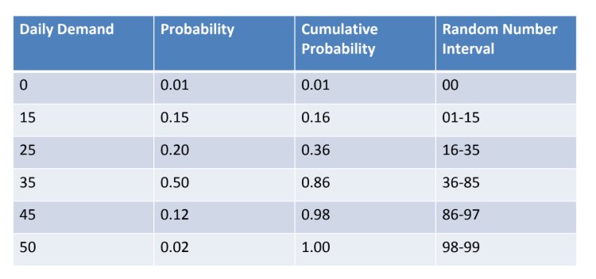
Establish probability distribution
Cumulative Probability Distribution
Setting Random Number Interval
0-0

Slide 62
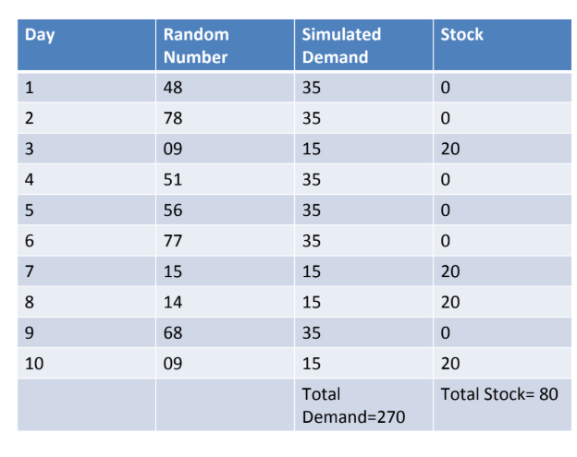
Generating Random Number
48,78,09,51,56,77,15,14,68,09
Average daily demand = 270/10 = 27

Slide 63
Q. Strong is a dentist who schedules all her patients for 30 minutes appointments. Some of the patients take more or less than 30 minutes depending on the type of dental work to be done. The following summary shows the various categories of work, and the time actually needed to complete the work:-
Use monte carlo simulation to find average waiting time of patients as well as idle time of doctor if clinic operates for 4 hours. Assume all patients arrive at clinic on scheduled time with arrival time starting at 8:00 am.
Use following random numbers
40,82,11,34,25,66,17,79
Category | Time Required | No. of Patients
Filling | 45min | 40
Crown | 60min | 15
Cleaning | 15min | 15
Extracting | 45min | 10
Checkup | 15min | 20

Slide 64
Category | Time Required | No. of Patients | Probability Distribution
Filling | 45min | 40 | 0.4
Crown | 60min | 15 | 0.15
Cleaning | 15min | 15 | 0.15
Extracting | 45min | 10 | 0.1
Checkup | 15min | 20 | 0.2

Slide 65
Category | Time Required | No. of Patients | Probability Distribution | Cumulative Probability
Filling | 45min | 40 | 0.4 | 0.4
Crown | 60min | 15 | 0.15 | 0.55
Cleaning | 15min | 15 | 0.15 | 0.70
Extracting | 45min | 10 | 0.1 | 0.80
Checkup | 15min | 20 | 0.2 | 1.00

Slide 66
Category | Time Required | No. of Patients | Probability Distribution | Cumulative Probability | Random Number Interval
Filling | 45min | 40 | 0.40 | 0.40 | 0-39
Crown | 60min | 15 | 0.15 | 0.55 | 40-54
Cleaning | 15min | 15 | 0.15 | 0.70 | 55-69
Extracting | 45min | 10 | 0.10 | 0.80 | 70-79
Checkup | 15min | 20 | 0.20 | 1.00 | 80-99

Slide 67
Patient | Scheduled Arrival | Random Number | Category | Service Time Needed
1 | 8:00 | 40 | Crown | 60min
2 | 8:30 | 82 | Checkup | 15min
3 | 9:00 | 11 | Filling | 45min
4 | 9:30 | 34 | Filling | 45min
5 | 10:00 | 25 | Filling | 45min
6 | 10:30 | 66 | Cleaning | 15min
7 | 11:00 | 17 | Filling | 45min
8 | 11:30 | 79 | Extracting | 45min

Slide 68
Patient | Scheduled Arrival | Service Start | Service duration | Service Ends | Waiting time(mins) | Idle time
1 | 8:00 | 8:00 | 60min | 9:00 | 0 | 0
2 | 8:30 | 9:00 | 15min | 9:15 | 30 | 0
3 | 9:00 | 9:15 | 45min | 10:00 | 15 | 0
4 | 9:30 | 10:00 | 45min | 10:45 | 30 | 0
5 | 10:00 | 10:45 | 45min | 11:30 | 45 | 0
6 | 10:30 | 11:30 | 15min | 11:45 | 60 | 0
7 | 11:00 | 11:45 | 45min | 12:30 | 45 | 0
8 | 11:30 | 12:30 | 45min | 1:15 | 60 | 0
 |  |  |  |  | Total =285
Average waiting time = 285/8 = 35

Slide 69
Q. An air force station has a schedule of 15 transport flights leaving per day, each with one pilot. Three reserve pilots are available to replace any pilot who falls sick. The probability distribution for the daily number of pilots who fall sick is as follows:
Use the Monte Carlo simulation to estimate the utilization of reserved pilots. What is the probability of canceling one flight due to non-availability of pilot? Simulate the system for 5 days.
Number of pilots sick | 0 | 1 | 2 | 3 | 4 | 5
Probability | 0.15 | 0.20 | 0.25 | 0.15 | 0.15 | 0.10

